Slide 1
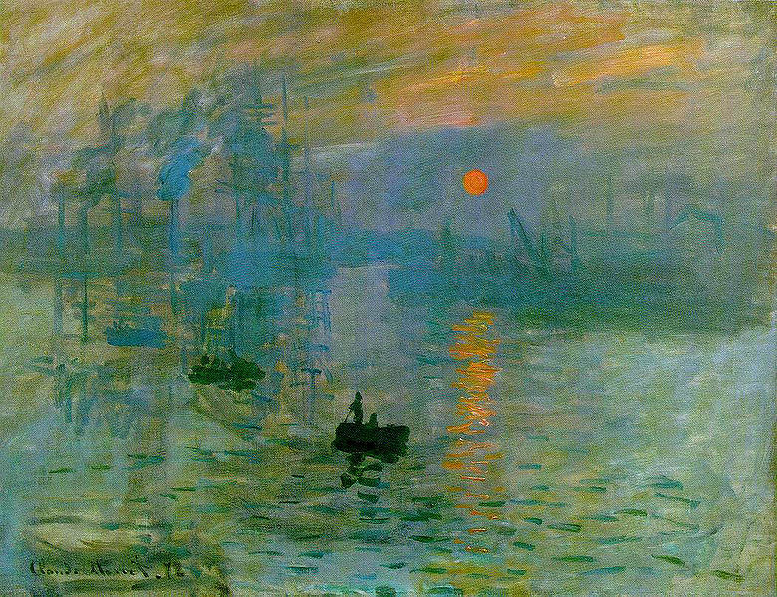
“Sunrise”
Claude Monet, 1872

Slide 2
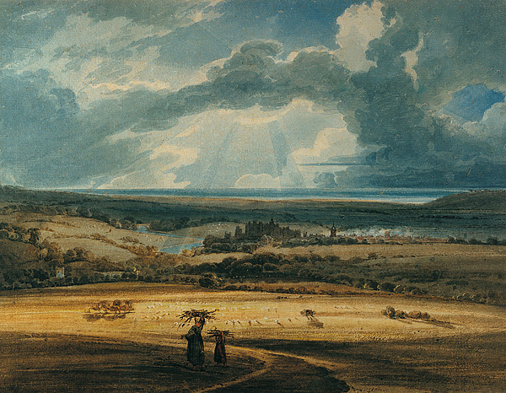
“Alnwick from Brizlee”
Thomas Girtin, 1800

Slide 3
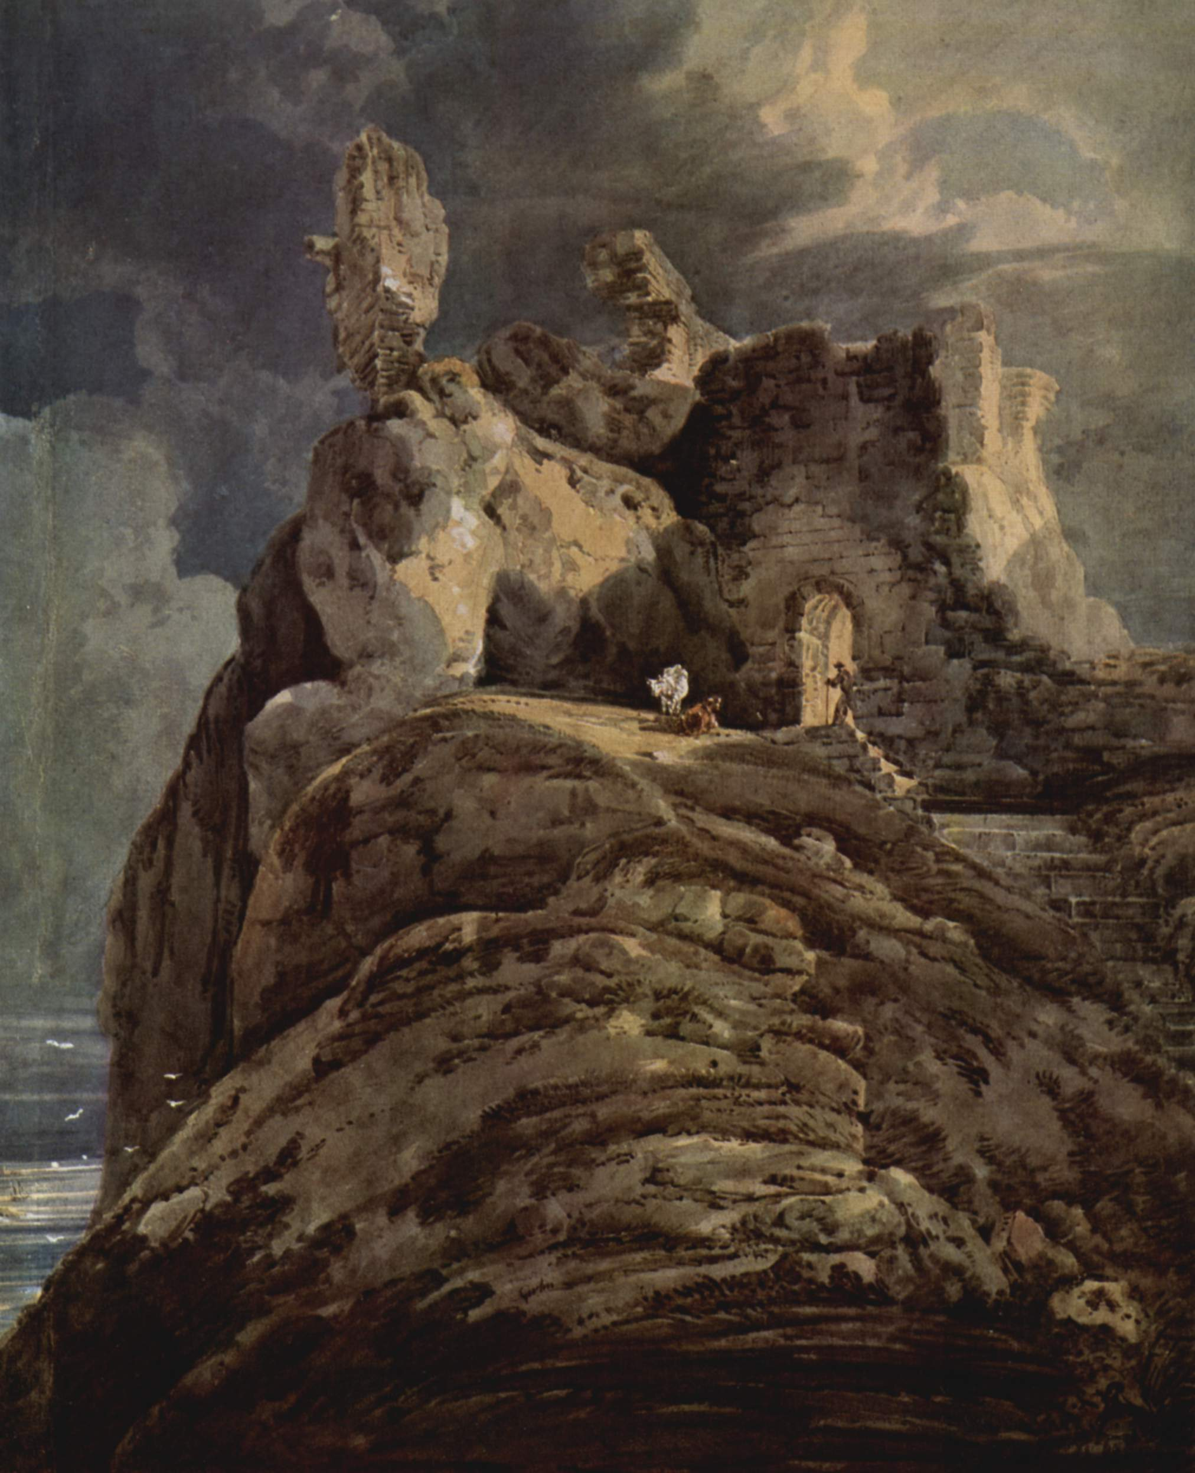
“Bamburgh Castle”
Thomas Girtin
1797-1799

Slide 4
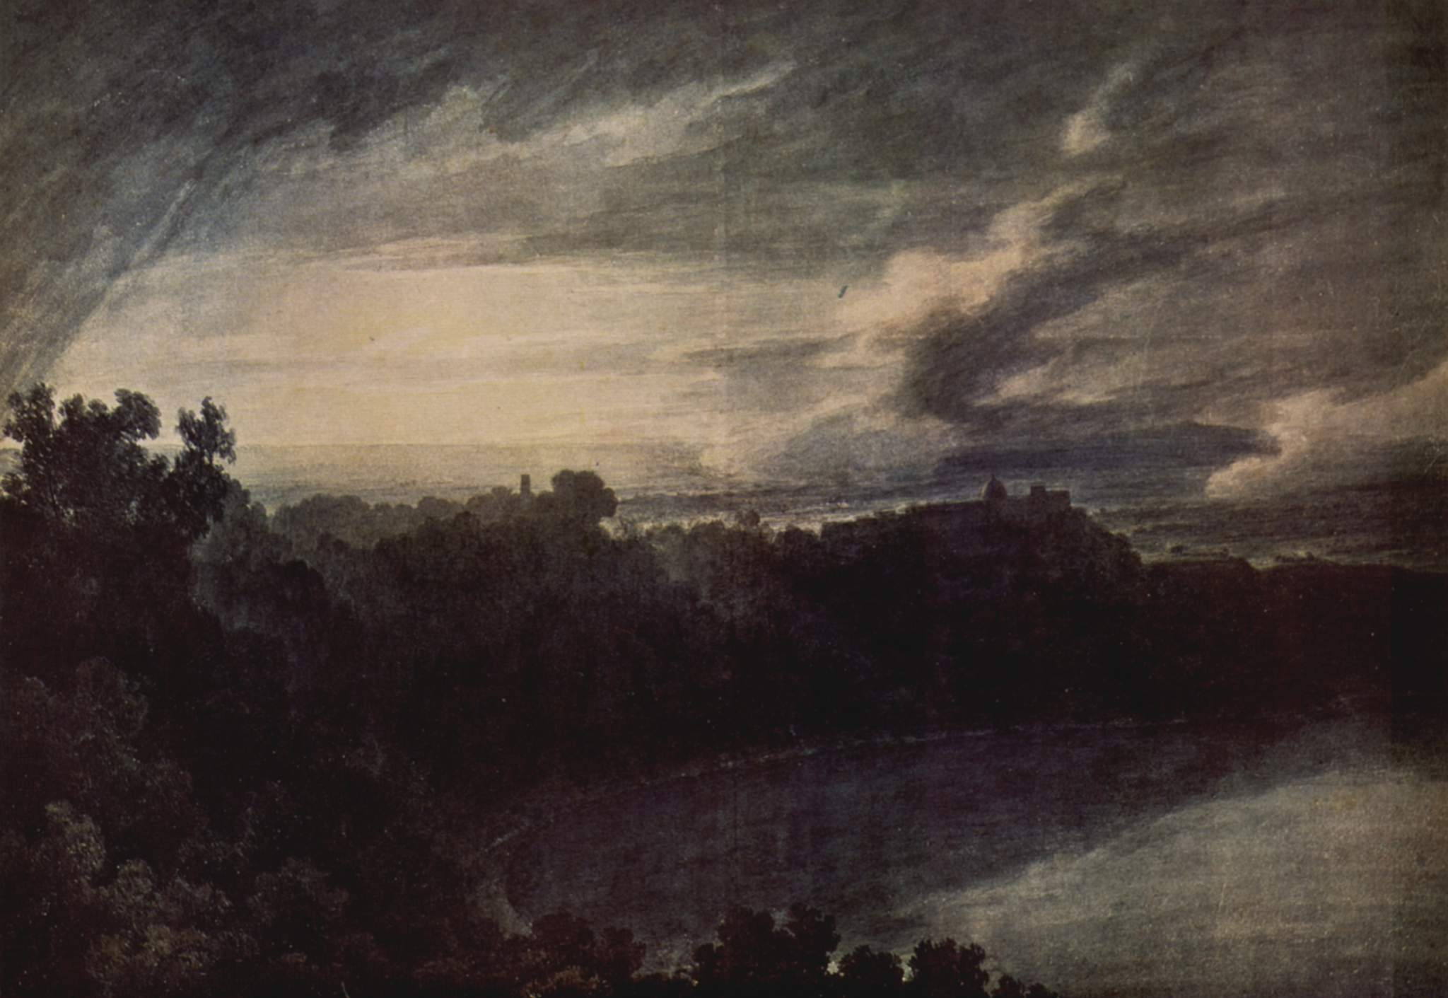
“Lake of Albano”
John Robert Cozens, 1777

Slide 5
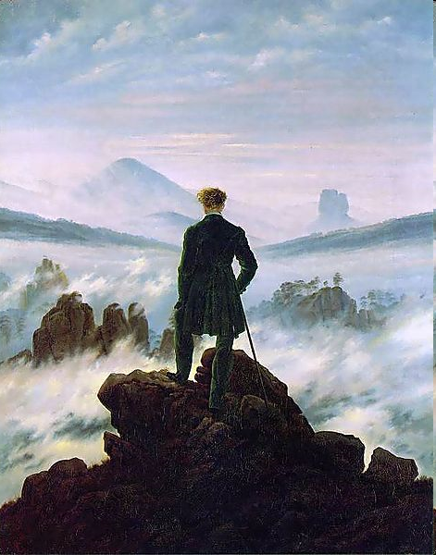
“The Wanderer Above the Sea of Fog”
Caspar David Friedrich, 1818

Slide 6
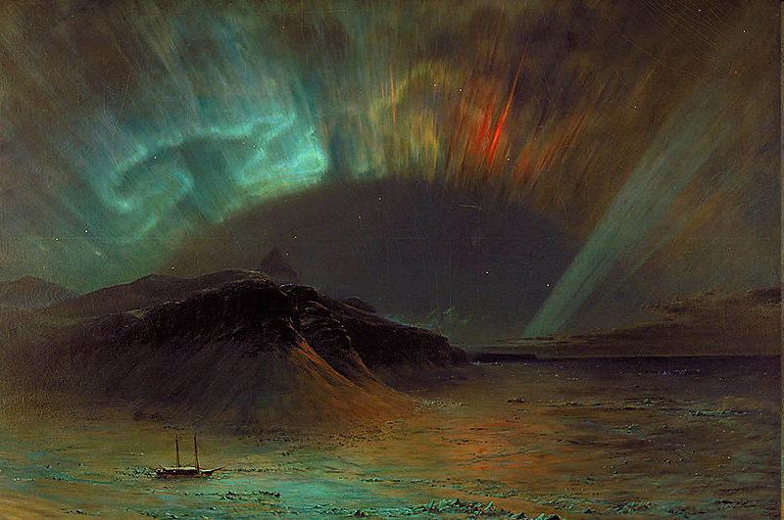
“Aurora Borealis”
Frederic Edwin Church, 1865

